Slide 1
Marketing Campaign Results
Marketing campaign data of 2,240 customers of Maven Marketing, including customer profiles, product preferences, campaign successes/failures, and channel performance.
Dataset Link:
https://www.kaggle.com/datasets/deepaksaw/marketing-dataset

Slide 2
Recommended Analysis
Are there any null values or outliers? How will you handle them?
What factors are significantly related to the number of web purchases?
Which marketing campaign was the most successful?
What does the average customer look like?
Which products are performing best?
Which channels are underperforming?

Slide 3
Recommended Analysis
Are there any null values or outliers? How will you handle them?
Yes, we find 24 null values and some outliers. We replace the value of all the null values and outliers with the median.

Slide 4
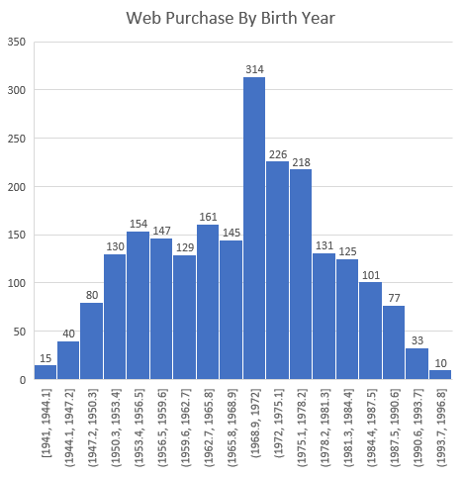
Recommended Analysis
2. What factors are significantly related to the number of web purchases?

Slide 5
Recommended Analysis
3. Which marketing campaign was the most successful?
Market Campaign 4 is the most Successful.

Slide 6
Recommended Analysis
4. What does the average customer look like?

Slide 7
Recommended Analysis
5. Which products are performing best?
Wines | Fruits | MeatProducts | FishProducts | SweetProducts | GoldProds
680019 | 58797 | 373465 | 83924 | 60430 | 98324
Wines are performing best product.

Slide 8
Recommended Analysis
6 . Which channels are underperforming?
Web Purchases | CatalogPurchases | StorePurchases | DealsPurchases
9135 | 5954 | 12950 | 5204
Deals Purchases are Underperforming.

Slide 9
Thank you for your Attention

